Slide 1
Fabulous = F# Functional FOR YOUR APP
Don Syme, Microsoft Researcher, F# Contributor
+ assistance from Mark Mallibone, Jim Bennett, Jason Imison, Miguel de Icaza, Phillip Carter, Fabulous Community Contributors

Slide 2
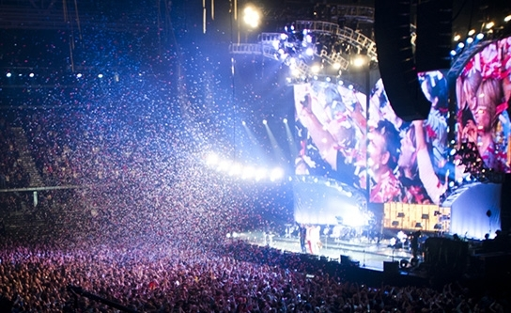

Slide 3
CAVEAT
This talk is informal, and not full of flashy demos
TLDR: please get involved with Fabulous!
Notes:
Some good options existed but hadn’t quite taken hold. “winforms designer! WPF designer! Xaml designer on Mac! webforms designer! Xcode designer! Class designer! class browser!”. Some semi-functional architectures too (WebSharper UI.Next, Gjallahorn, others). ReactNative and other options are perceived as being functional-friendly. Can we make Xamarin friendly for F# developers?

Slide 4
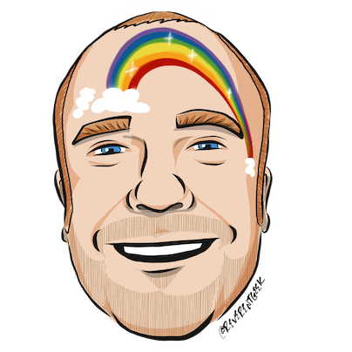







thanks
Timothé Larivière
co-maintainer on Fabulous, author of ElmishContacts and ElmishPlanets demos
Jim Bennett
Great talks on Fabulous!
Mark Mallibone
Swiss MVP , @mallibone
Frank Krueger
ImmutableUI was inspiration and initial partial list of Xamarin.Core bindings
Boris D. (github @dboris)
authored “Elmish.Forms” (“half-elmish” for static views only)
Jason Imison
F# in Visual Studio for Mac and Xamarin
Eugene Tolmachev
Creator or “Elmish” for Fable, used for WPF and others
Justin Sacks and others
Creators of “Elmish.WPF” (“half-elmish” for static views only)
Alfonso, Maxime, Steffen and many others
The Fable gang

Slide 5
The context
Initially F# embraced functional-first programming but lacked opinion on functional-first app development
Fable solves this for Web
F# devs also need to be able to go Mobile
Can we make Xamarin a simple and compelling for F# app development?
Notes:
Some good options existed but hadn’t quite taken hold. “winforms designer! WPF designer! Xaml designer on Mac! webforms designer! Xcode designer! Class designer! class browser!”. Some semi-functional architectures too (WebSharper UI.Next, Gjallahorn, others). ReactNative and other options are perceived as being functional-friendly. Can we make Xamarin friendly for F# developers?

Slide 6

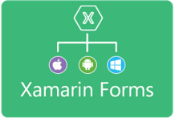












Situation: The world of UI is developing
OO programming
Complex mutable models
Declarative static UI
View in 2nd markup language
Complex designer tooling
Functional programming
Simple declarative models
Declarative dynamic UI
View in same language DSL
Simple live coding tooling
MVU
(model-view-update)
MVVM
(model-view-viewmodel)

Slide 7
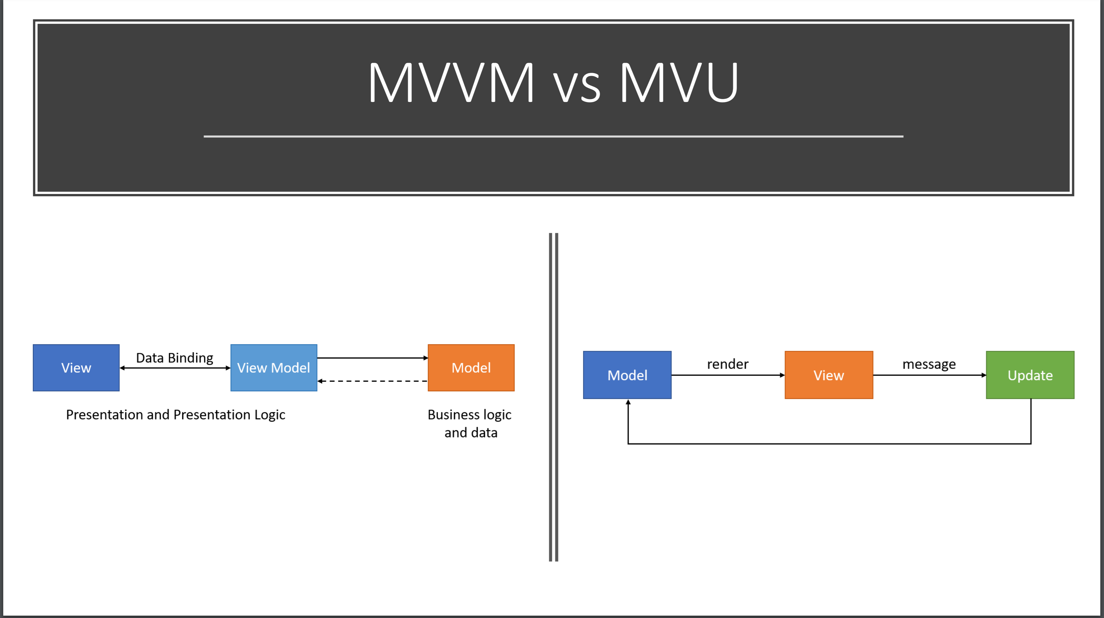

Slide 8
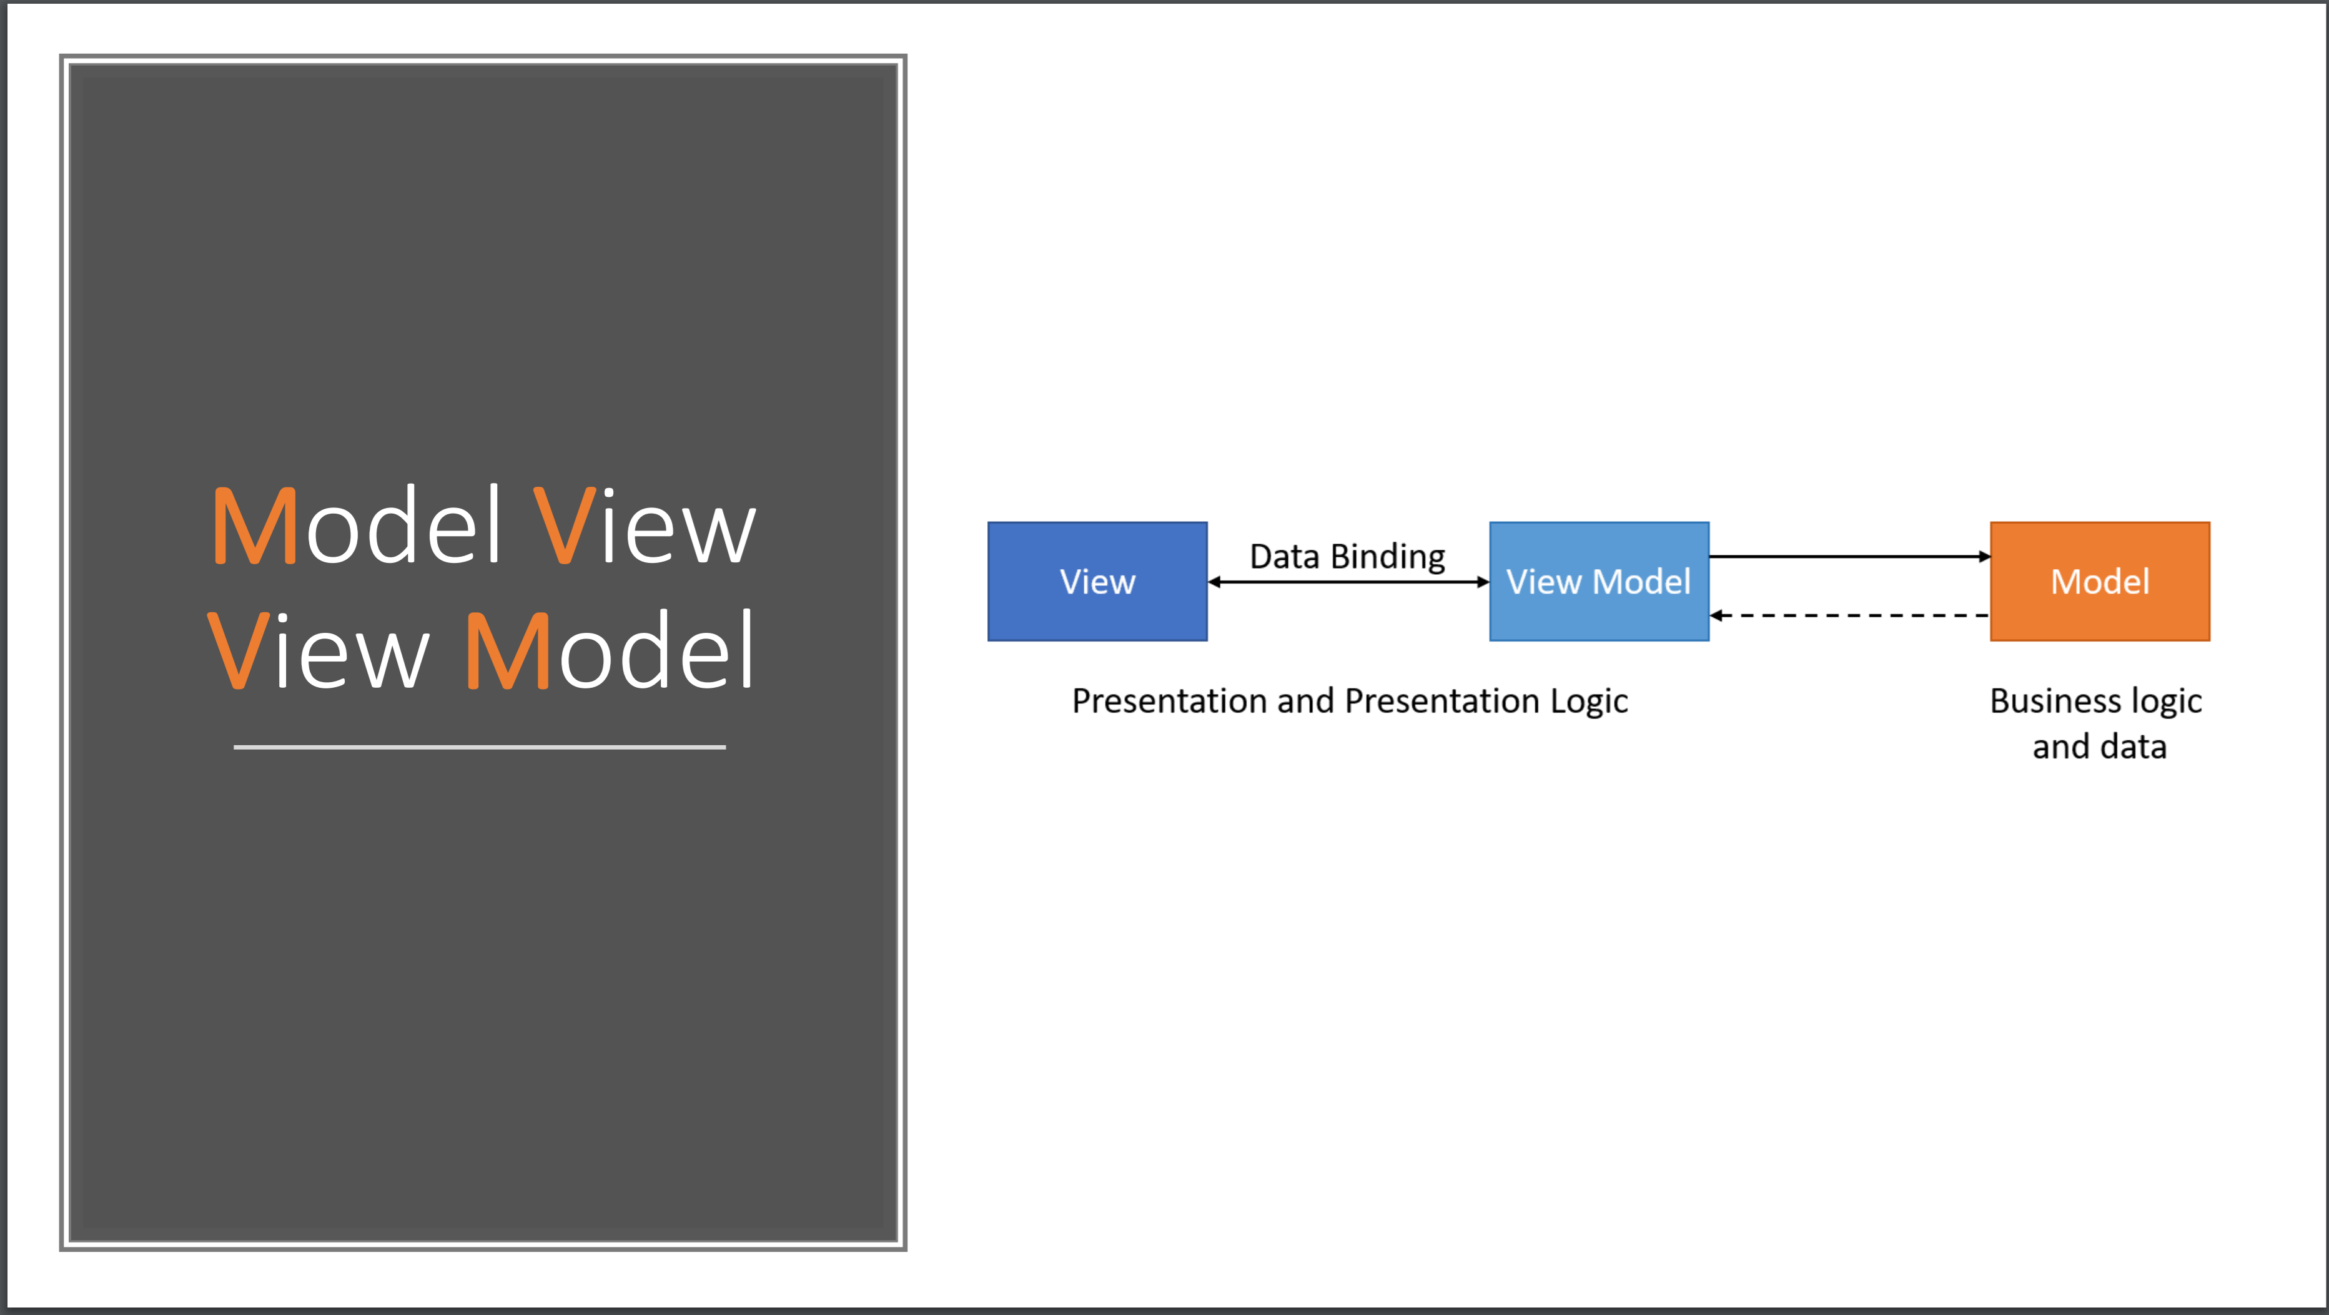

Slide 9
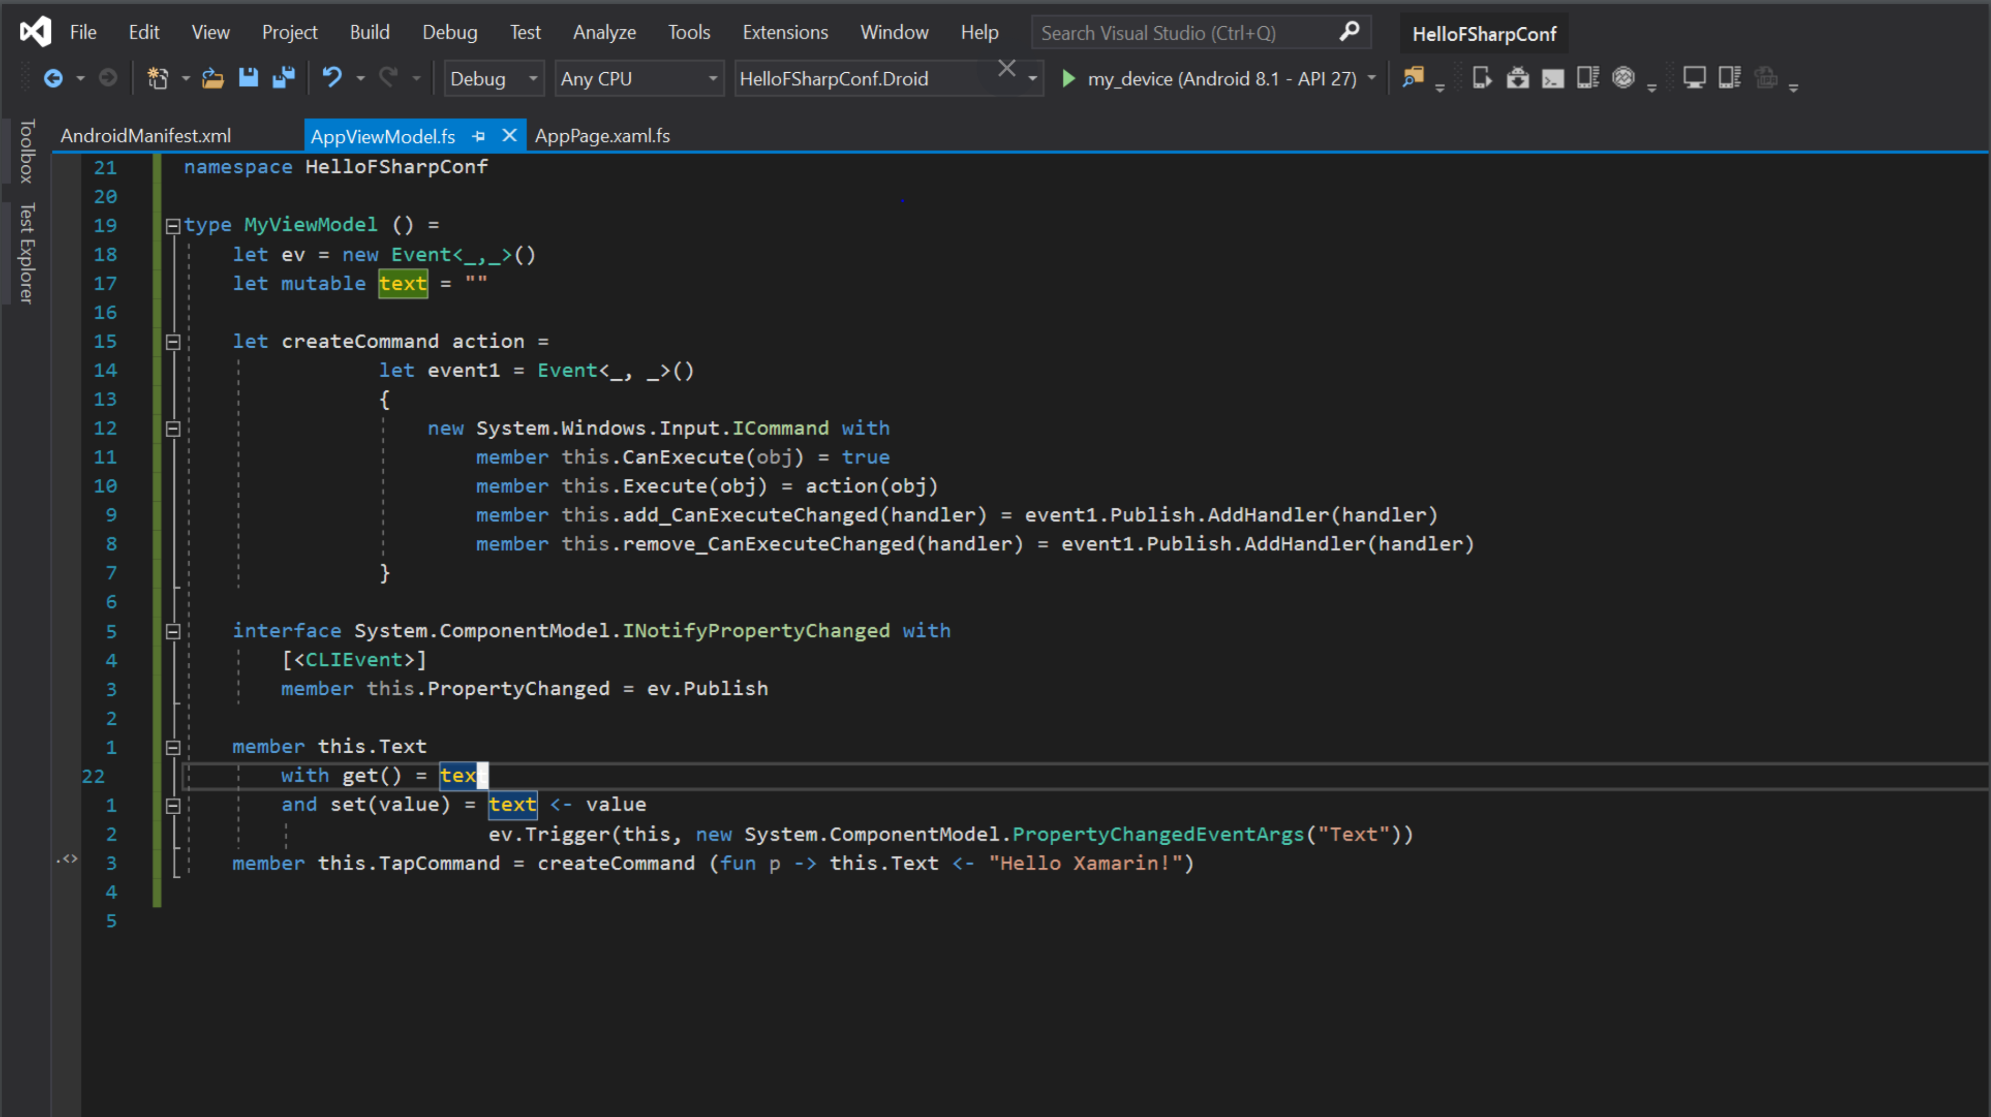

Slide 10
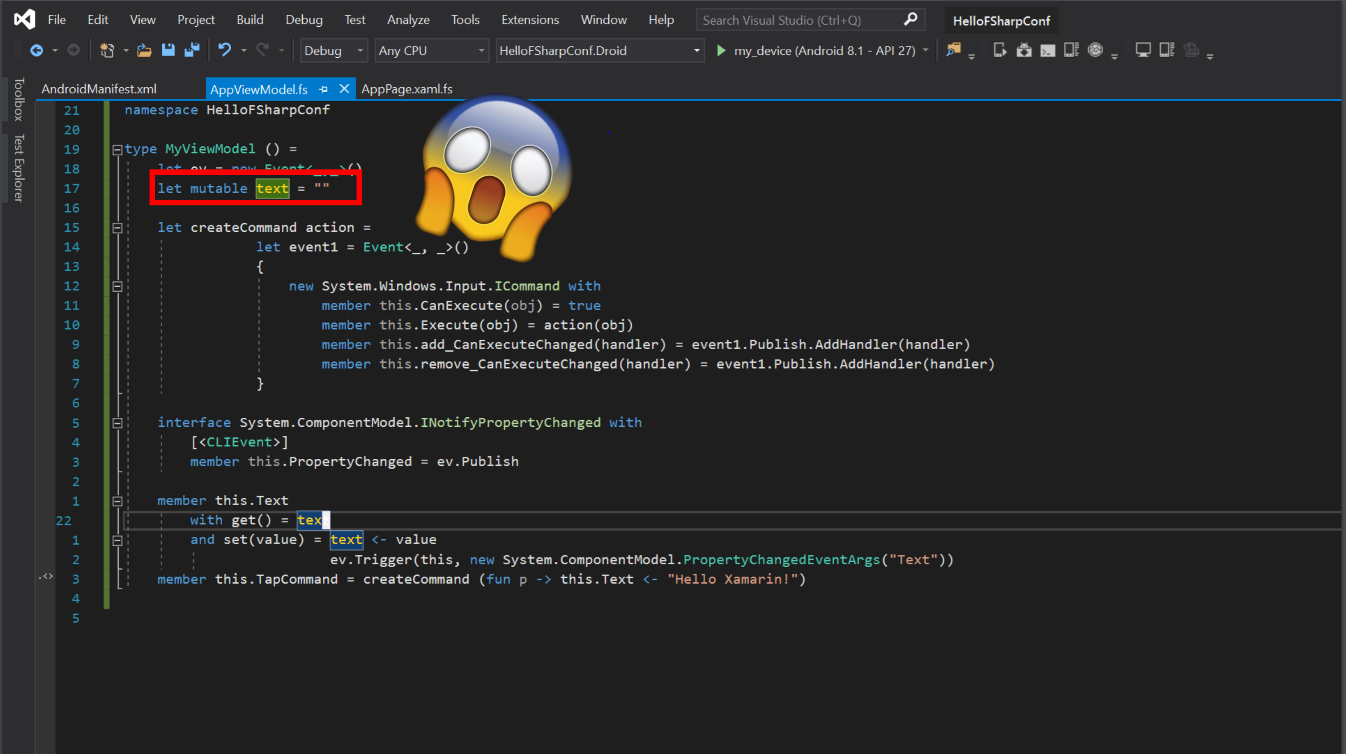

Slide 11
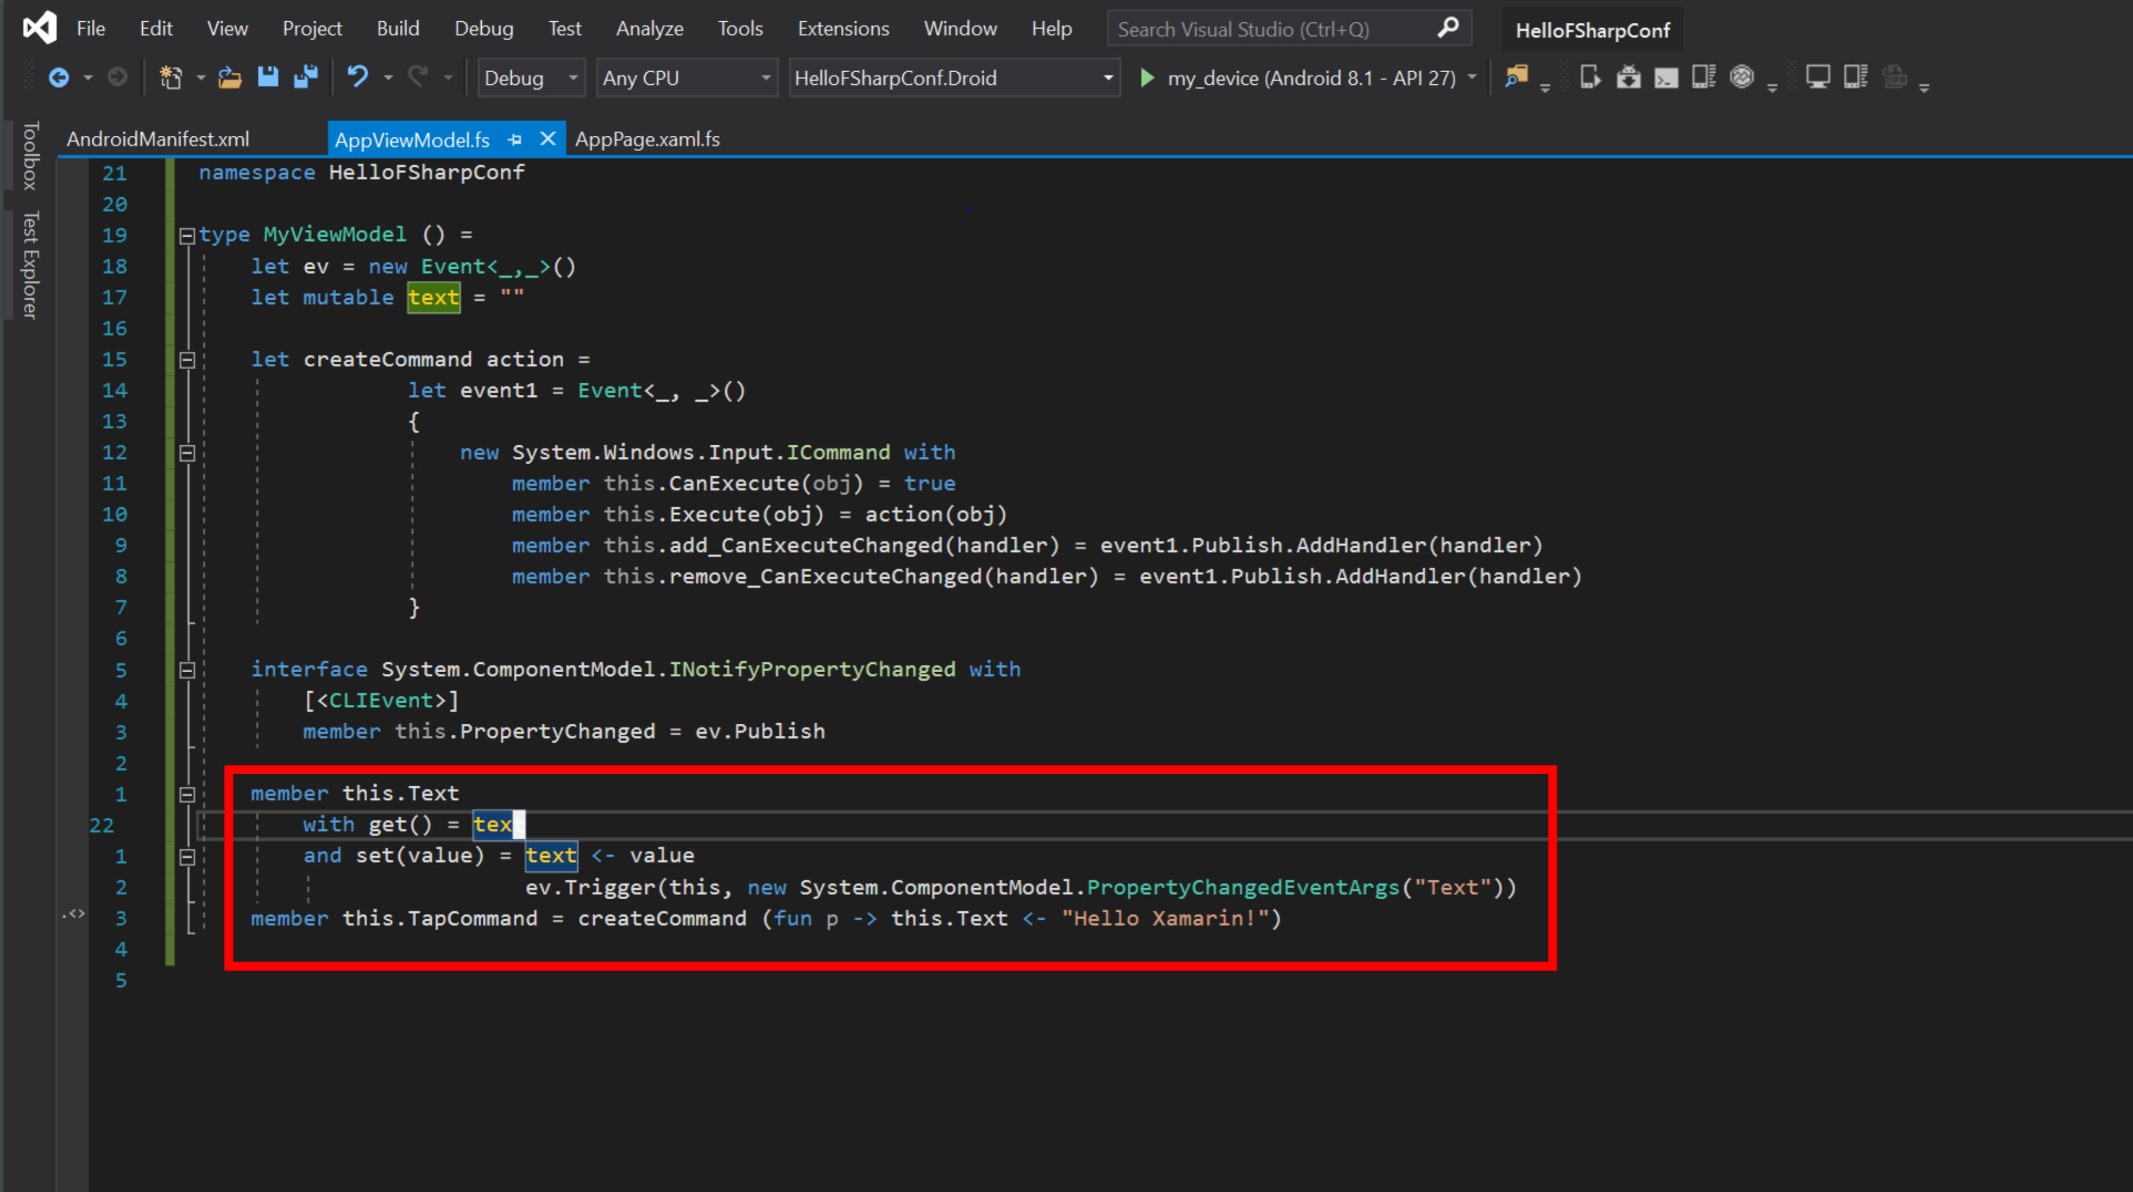

Slide 13
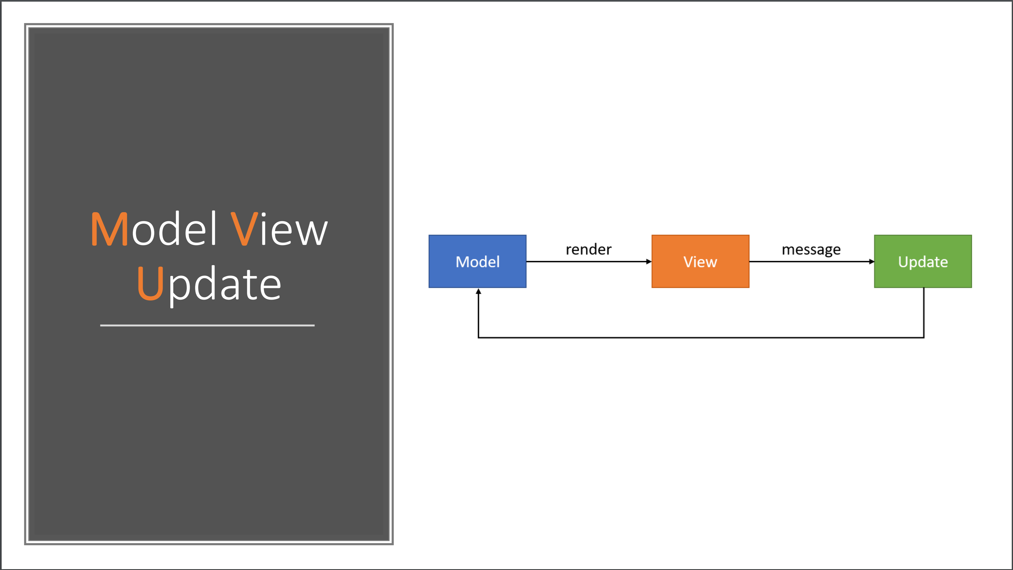

Slide 14
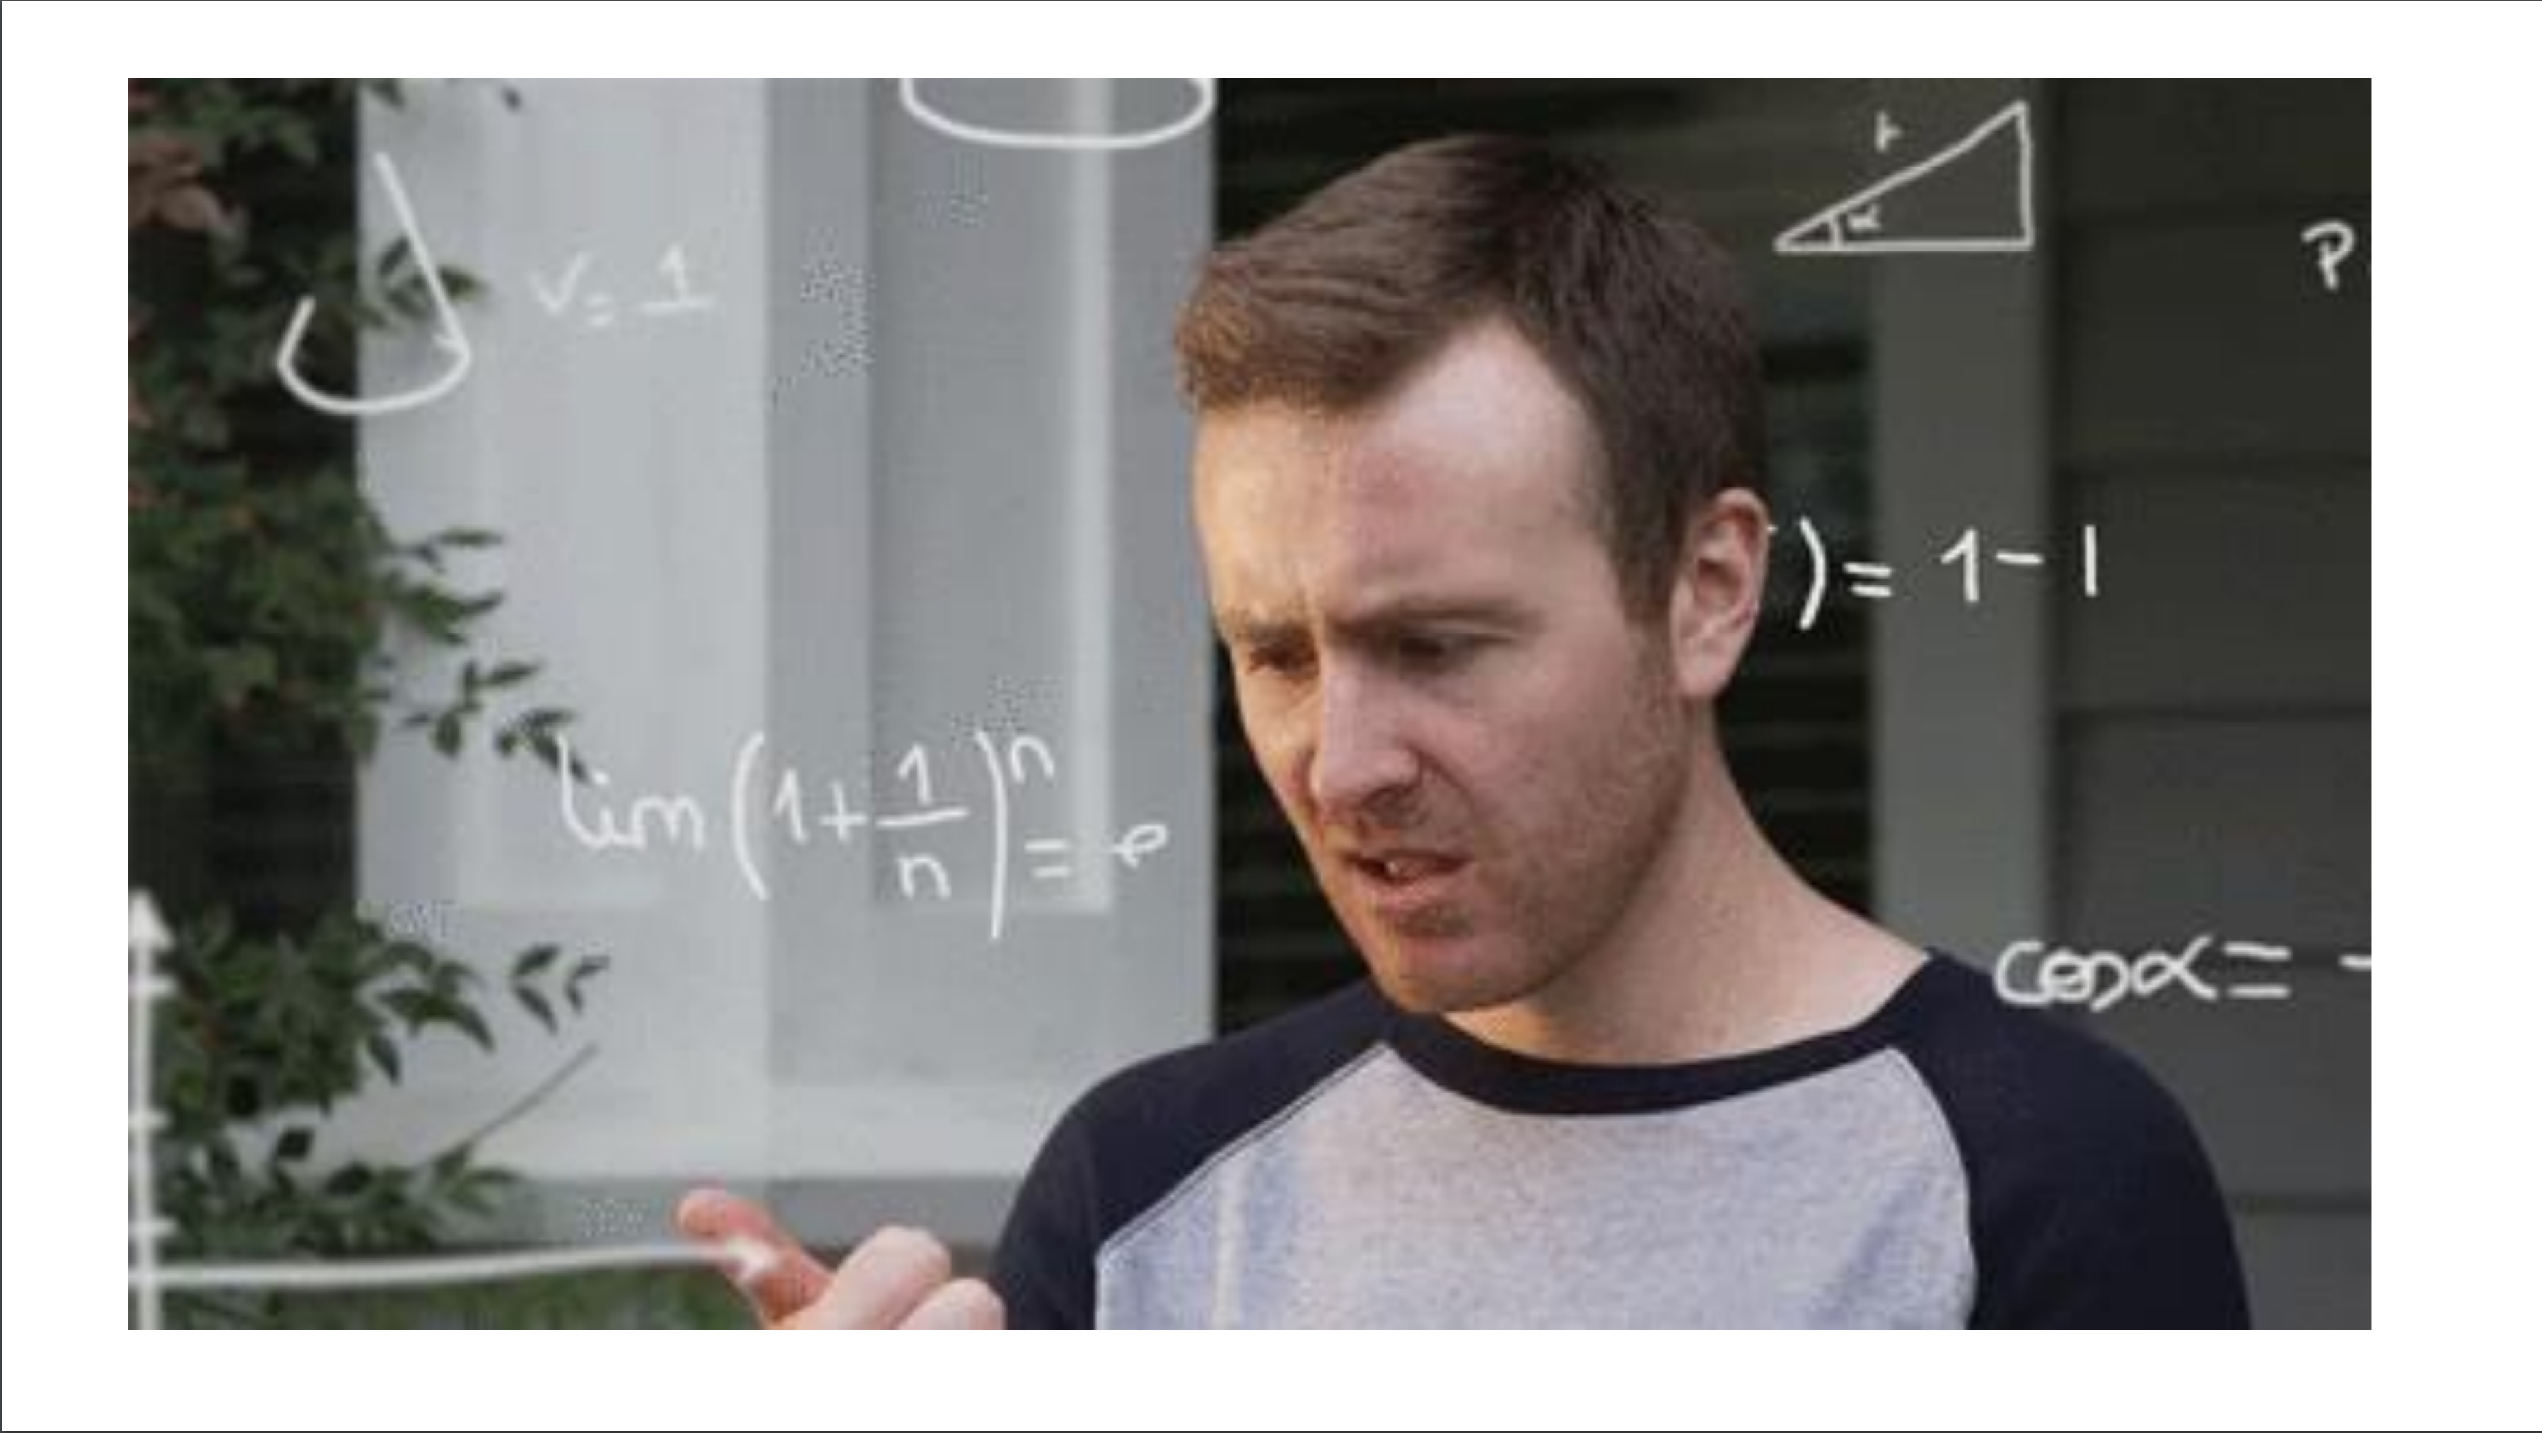

Slide 15
INSPIRATION
Fable has popularized the “Elm” architecture in F#
Fable+Elmish makes web app development simple
All F# code
View descriptions are separated but simple, and in F#
I’m very influenced by SAFE Stack
Non-F# people have found Fable+Elmish easy in business contexts
http://fable.io http://github.com/elmish
https://safe-stack.github.io/

Slide 16
THE PROBLEM WITH XAML
A core problem: Xaml
Xaml assumes “designers” will “sliced off” UI from code into a separate DSL.
Xaml is static, with layers of complexity (e.g. templating), and code-like constructs (behaviours, convertors), and requires complex designer tooling (which often fails).
Separating the UI is fine, but do we really need a separate language to do it?

Slide 17
THE PROBLEM WITH XAML
Existing F# UI development follows three architectures
Adhoc. WinForms plus callbacks.
MVVM #1. State in mutable UI controls and mutable model. View is static Xaml.
MVVM #2: #1 + compositional reactive updates
A core problem: Xaml is not simple
Xaml was designed so UI could be sliced off from code
So Xaml is static
But dynamic UI needs programming and Xaml is not a programming language
So Xaml ends up with baroque layers of complexity (e.g. templating), and code-like constructs (behaviours, convertors), and complex designer tooling (which often fails).
Separating the UI is fine, but do we really need a separate language to do it?
Xaml is a complexity disaster stemming from a fundamental category mistake in 2003 (“dynamic UI should be separated into a static markup language”)
That said, lots of people do F# + MVVM + Xaml with WPF and/or Xamarin.

Slide 18
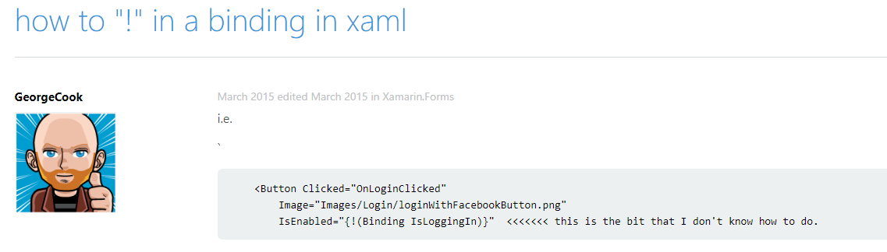
THE PROBLEM WITH XAML

Slide 19
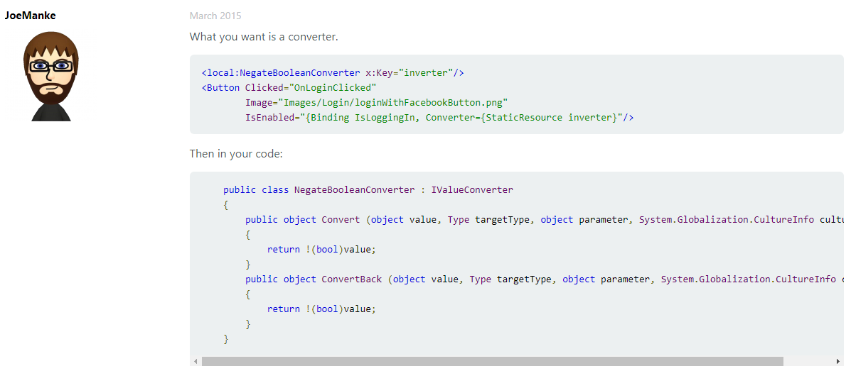
THE PROBLEM WITH XAML

Slide 20
The VIEW DSL
View looks like this:
let view (model: Model) dispatch =
View.ContentPage(content=
View.StackLayout(padding=30.0,verticalOptions = LayoutOptions.Center, children=[
View.Label(text= string model.Count, horizontalOptions=LayoutOptions.Center)
View.Button(text="Increment", command= (fun () -> dispatch Increment))
View.Button(text="Decrement", command= (fun () -> dispatch Decrement))
View.Slider(minimum=0.0, maximum=10.0, value=model.Step,
valueChanged= (fun args -> dispatch (SetStep (int args.NewValue))))
View.Label(text=sprintf "Step size: %d" model.Step, horizontalOptions=LayoutOptions.Center)
View.Button(text="Reset", horizontalOptions=LayoutOptions.Center,
command=(fun () -> dispatch Reset), canExecute = model.Changed)
]))

Slide 21
The VIEW DSL
View looks like this:
let view (model: Model) dispatch =
View.ContentPage(content=
View.StackLayout(padding=30.0,verticalOptions = LayoutOptions.Center, children=[
View.Label(text= string model.Count, horizontalOptions=LayoutOptions.Center)
View.Button(text="Increment", command= (fun () -> dispatch Increment))
View.Button(text="Decrement", command= (fun () -> dispatch Decrement))
View.Slider(minimum=0.0, maximum=10.0, value=model.Step,
valueChanged= (fun args -> dispatch (SetStep (int args.NewValue))))
View.Label(text=sprintf "Step size: %d" model.Step, horizontalOptions=LayoutOptions.Center)
View.Button(text="Reset", horizontalOptions=LayoutOptions.Center,
command=(fun () -> dispatch Reset), canExecute = not model.Unchanged)
]))
How easy is that?

Slide 22
THE NEED
What’s needed?
the simplicity of Fable + Elmish, but for Apps
(aside: you can do Fable+Elmish to ReactNative already)

Slide 23
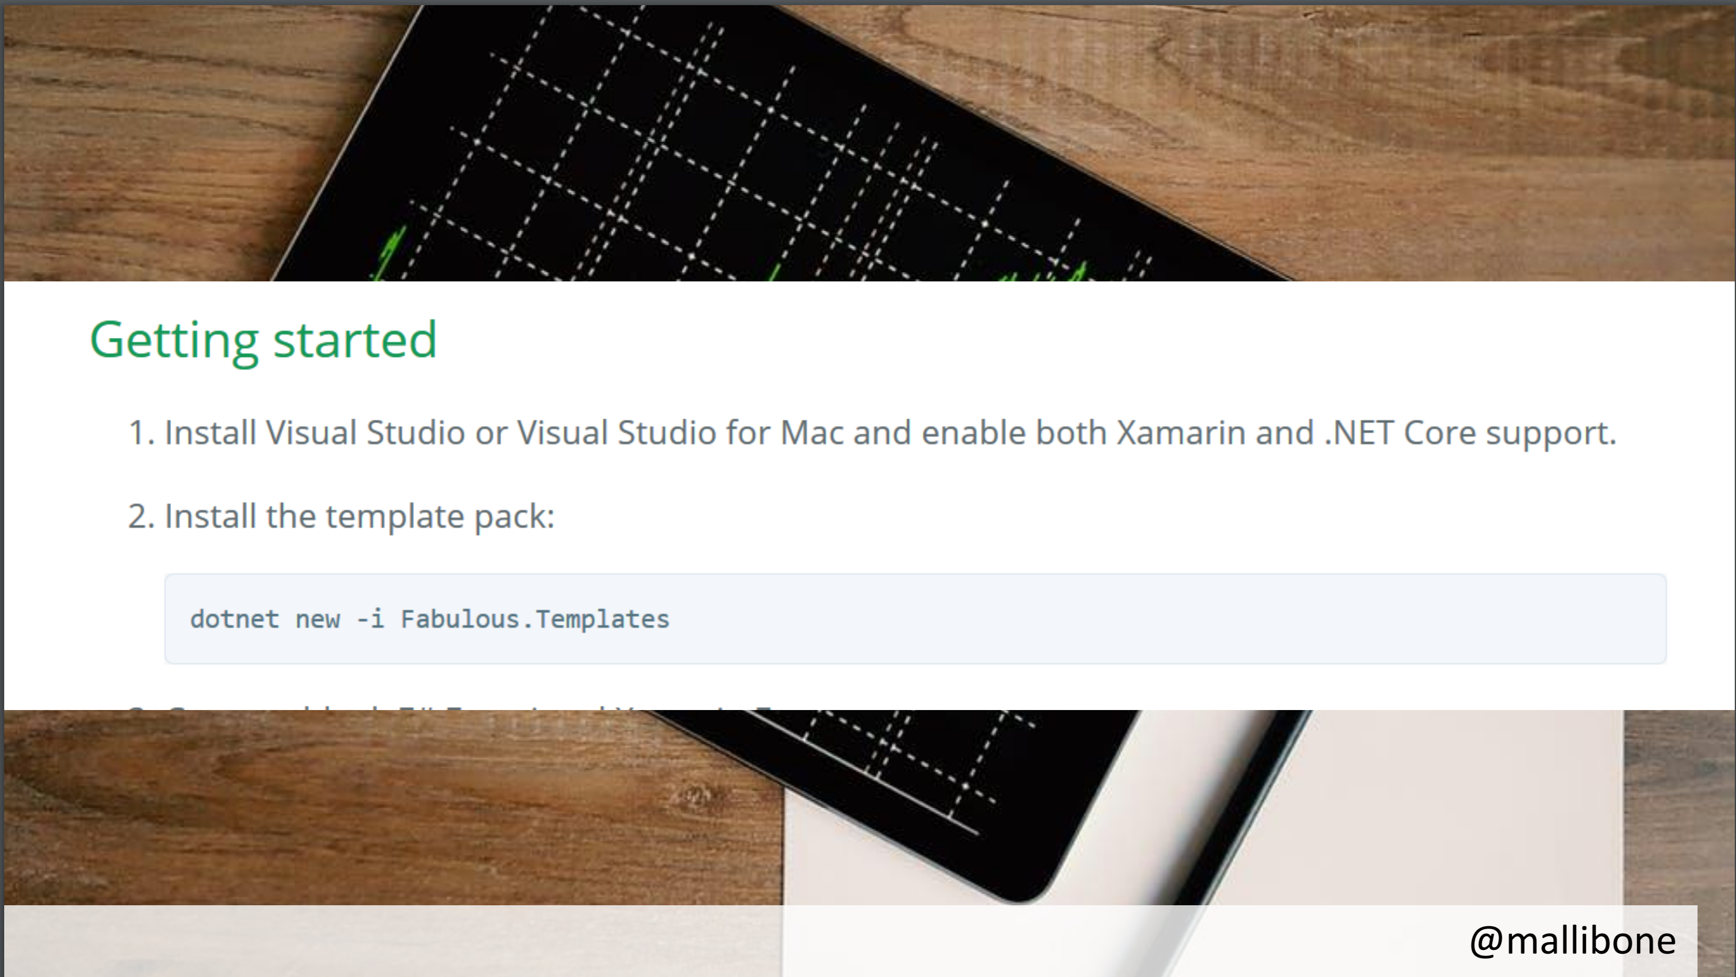

Slide 24
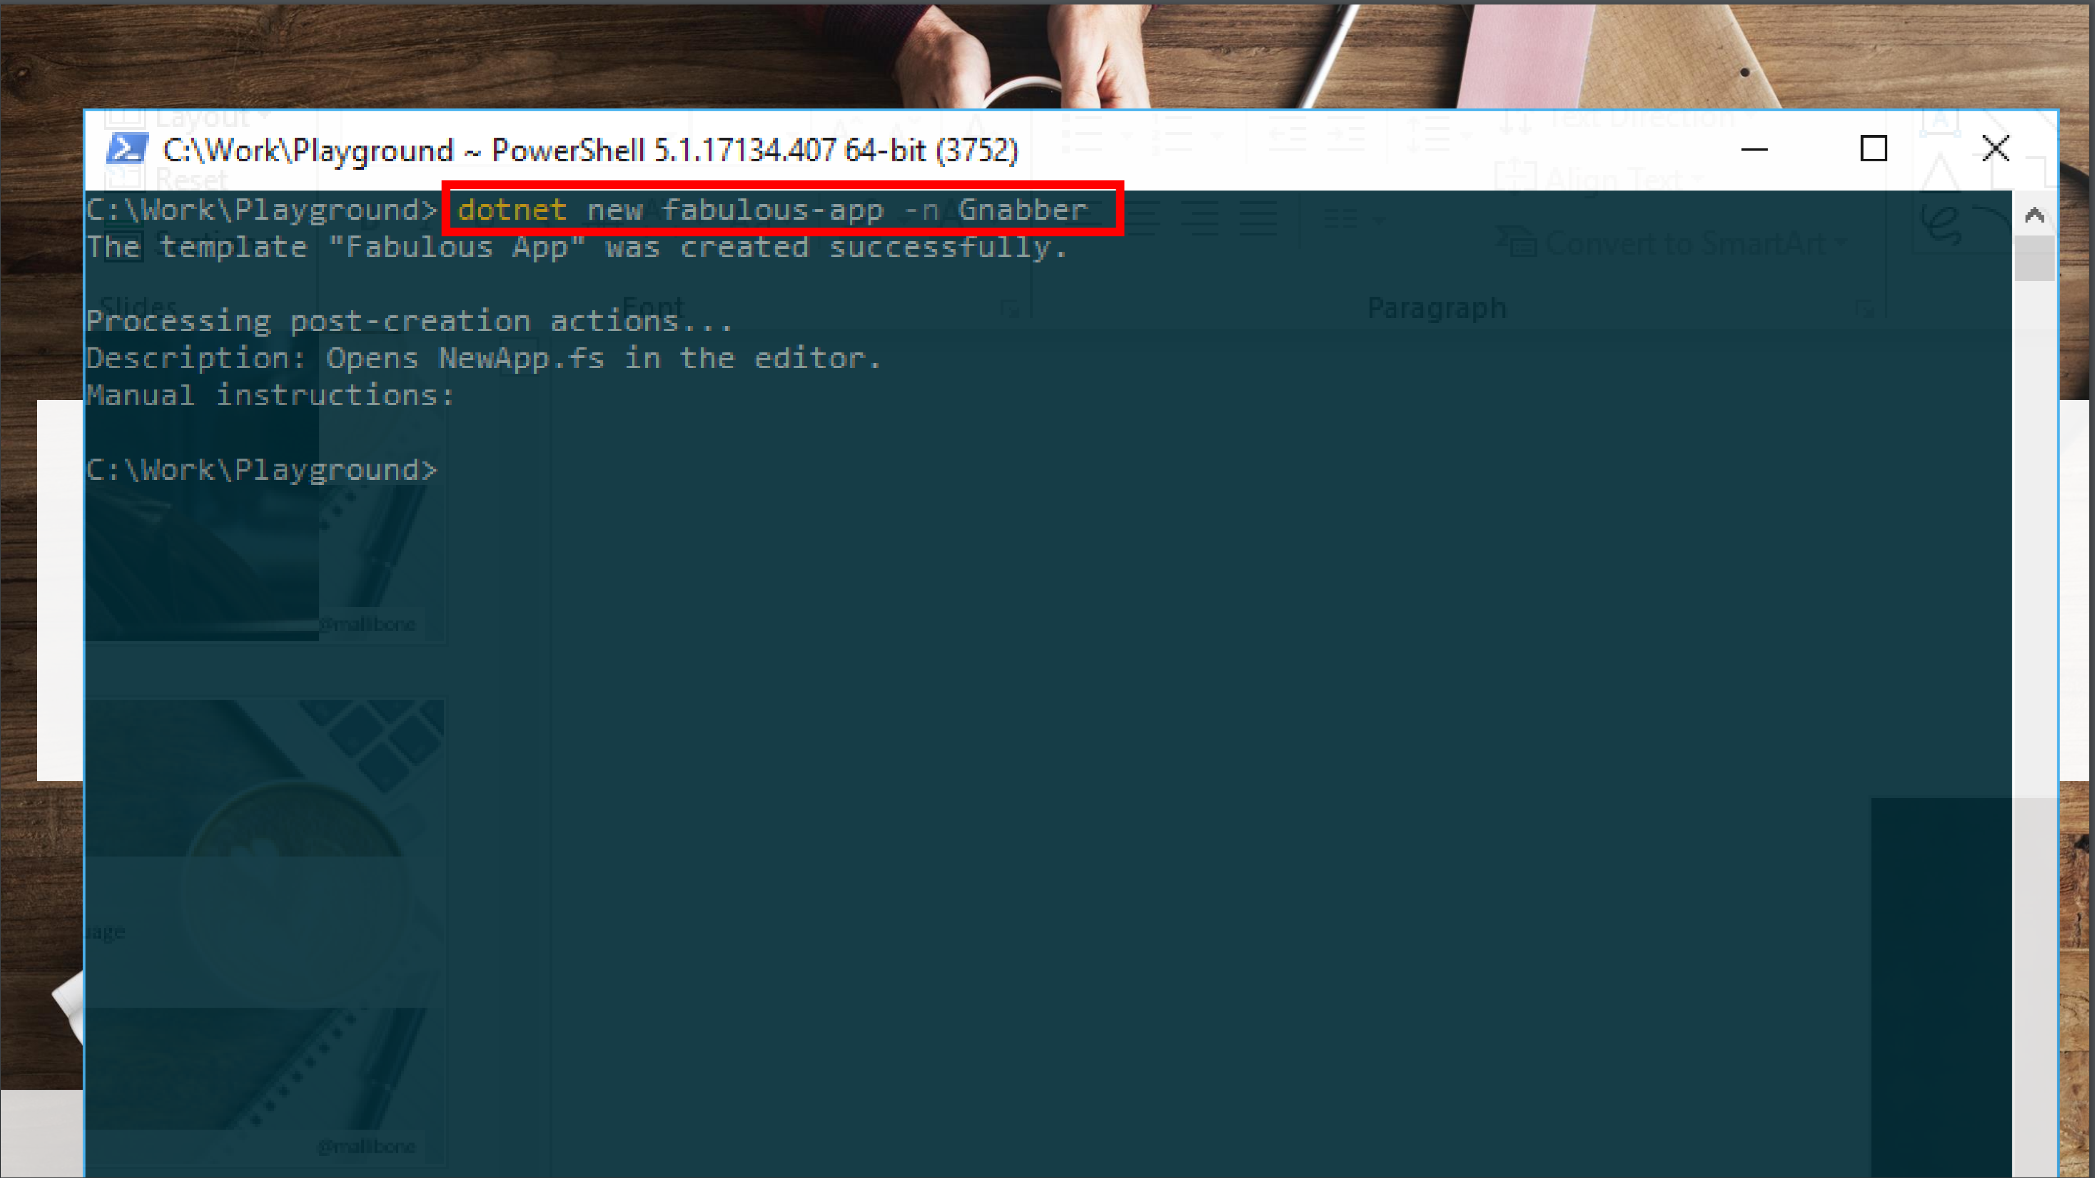

Slide 25
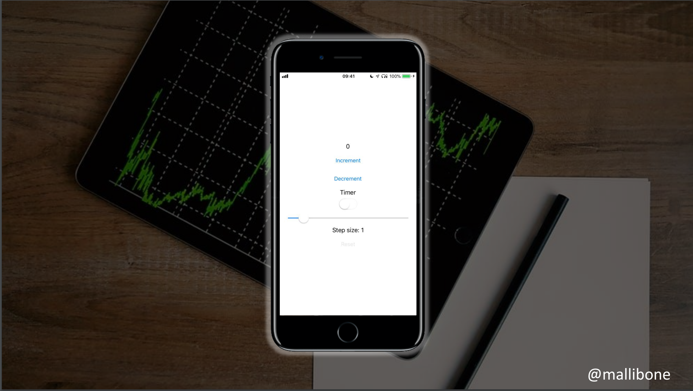

Slide 26
Demo I

Slide 27
A Simple MVU App
type Model =
{ … }
type Msg =
| …
| …
let init() =
{ … }
let update msg model =
match msg with
| … -> { model with … }
| … -> { model with … }
let view model dispatch =
if model.IsPressed then
… dispatch msg …
else
… dispatch msg …
The model from which
the view is generated
Messages which cause
updates to the model
Initial state
Update the model
Compute the view

Slide 28
A Simple MVU App
type Model =
{ IsPressed: bool }
type Msg =
| Pressed
let init() =
{ IsPressed=false }
let update (msg: Msg) (model: Model) =
match msg with
| Pressed -> { model with IsPressed = true }
let view (model: Model) dispatch =
if model.IsPressed then
View.Label(text="I was pressed!")
else
View.Button(text="Press Me!", command=(fun () -> dispatch Pressed))
The model from which
the view is generated
Messages which cause
updates to the model
Initial state
Update the model
Compute the view

Slide 29
MVU
It’s all just functional programming
UI becomes a information-flow problem
Views and model update are just functional programming
Views are re-computed
New view applied to underlying controls using differential update
If view hasn’t changed, no updates are made
Messages are explicit and easy to trace

Slide 30
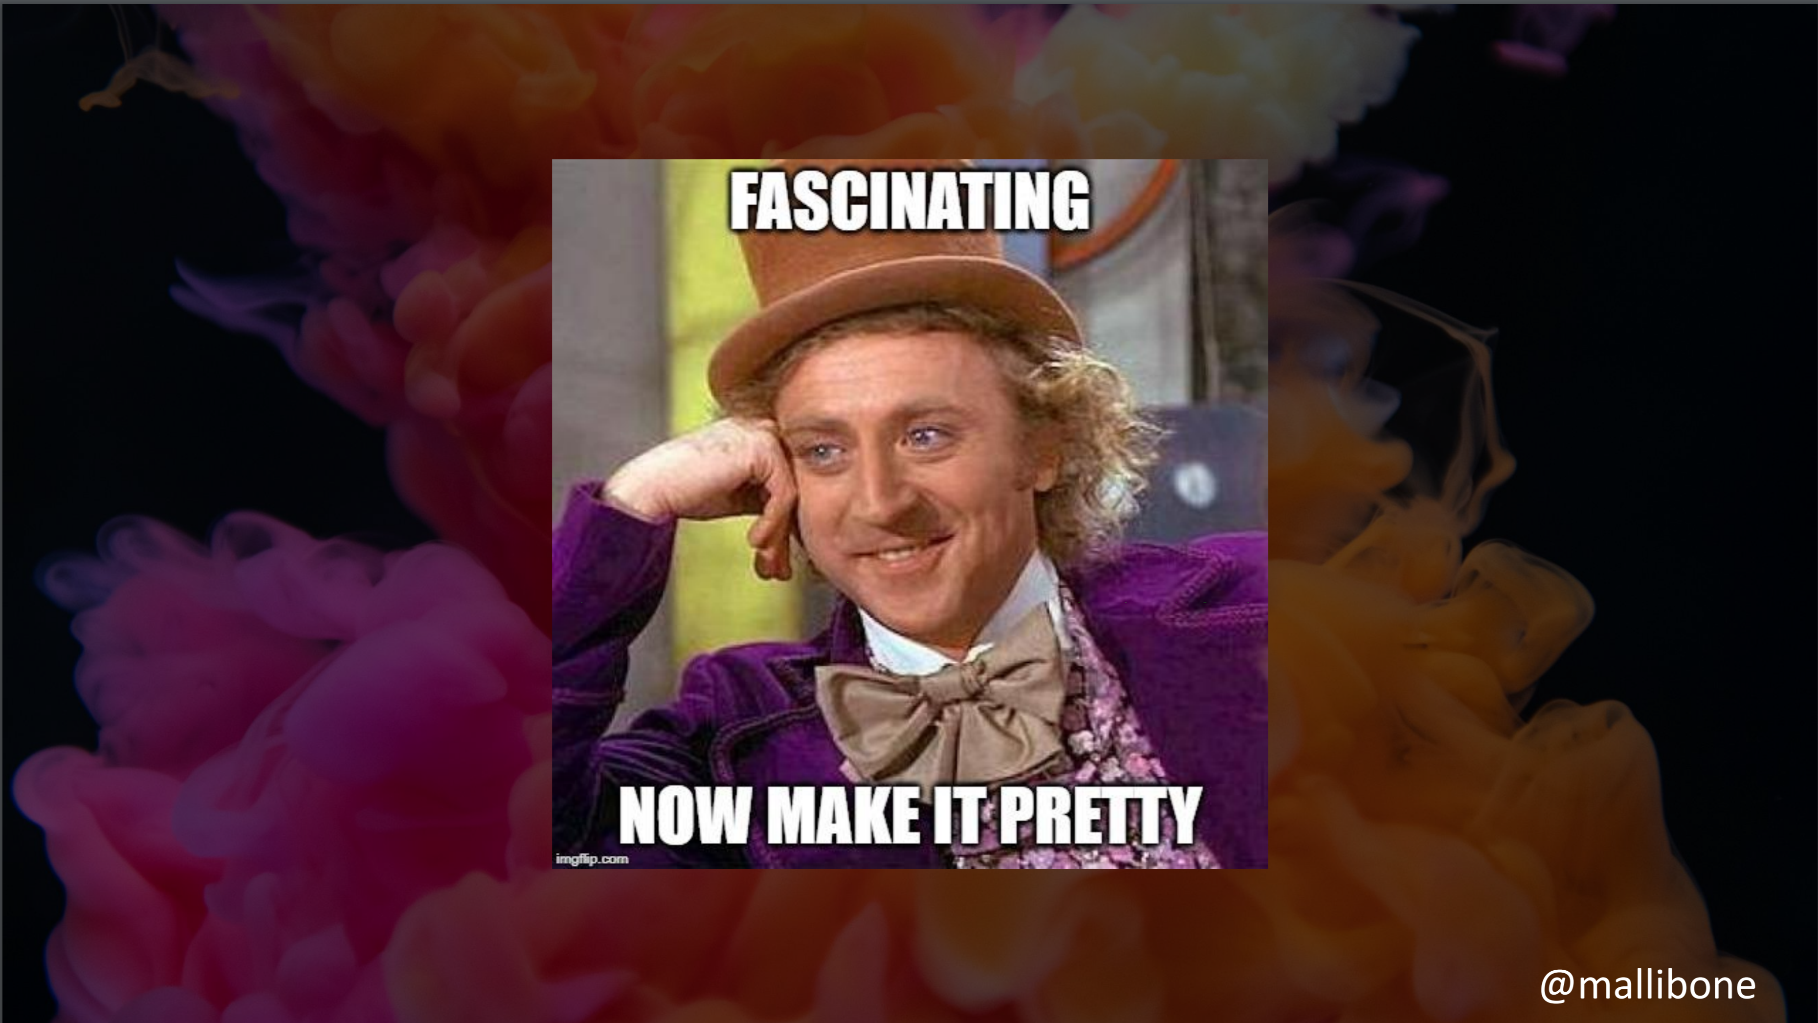

Slide 31
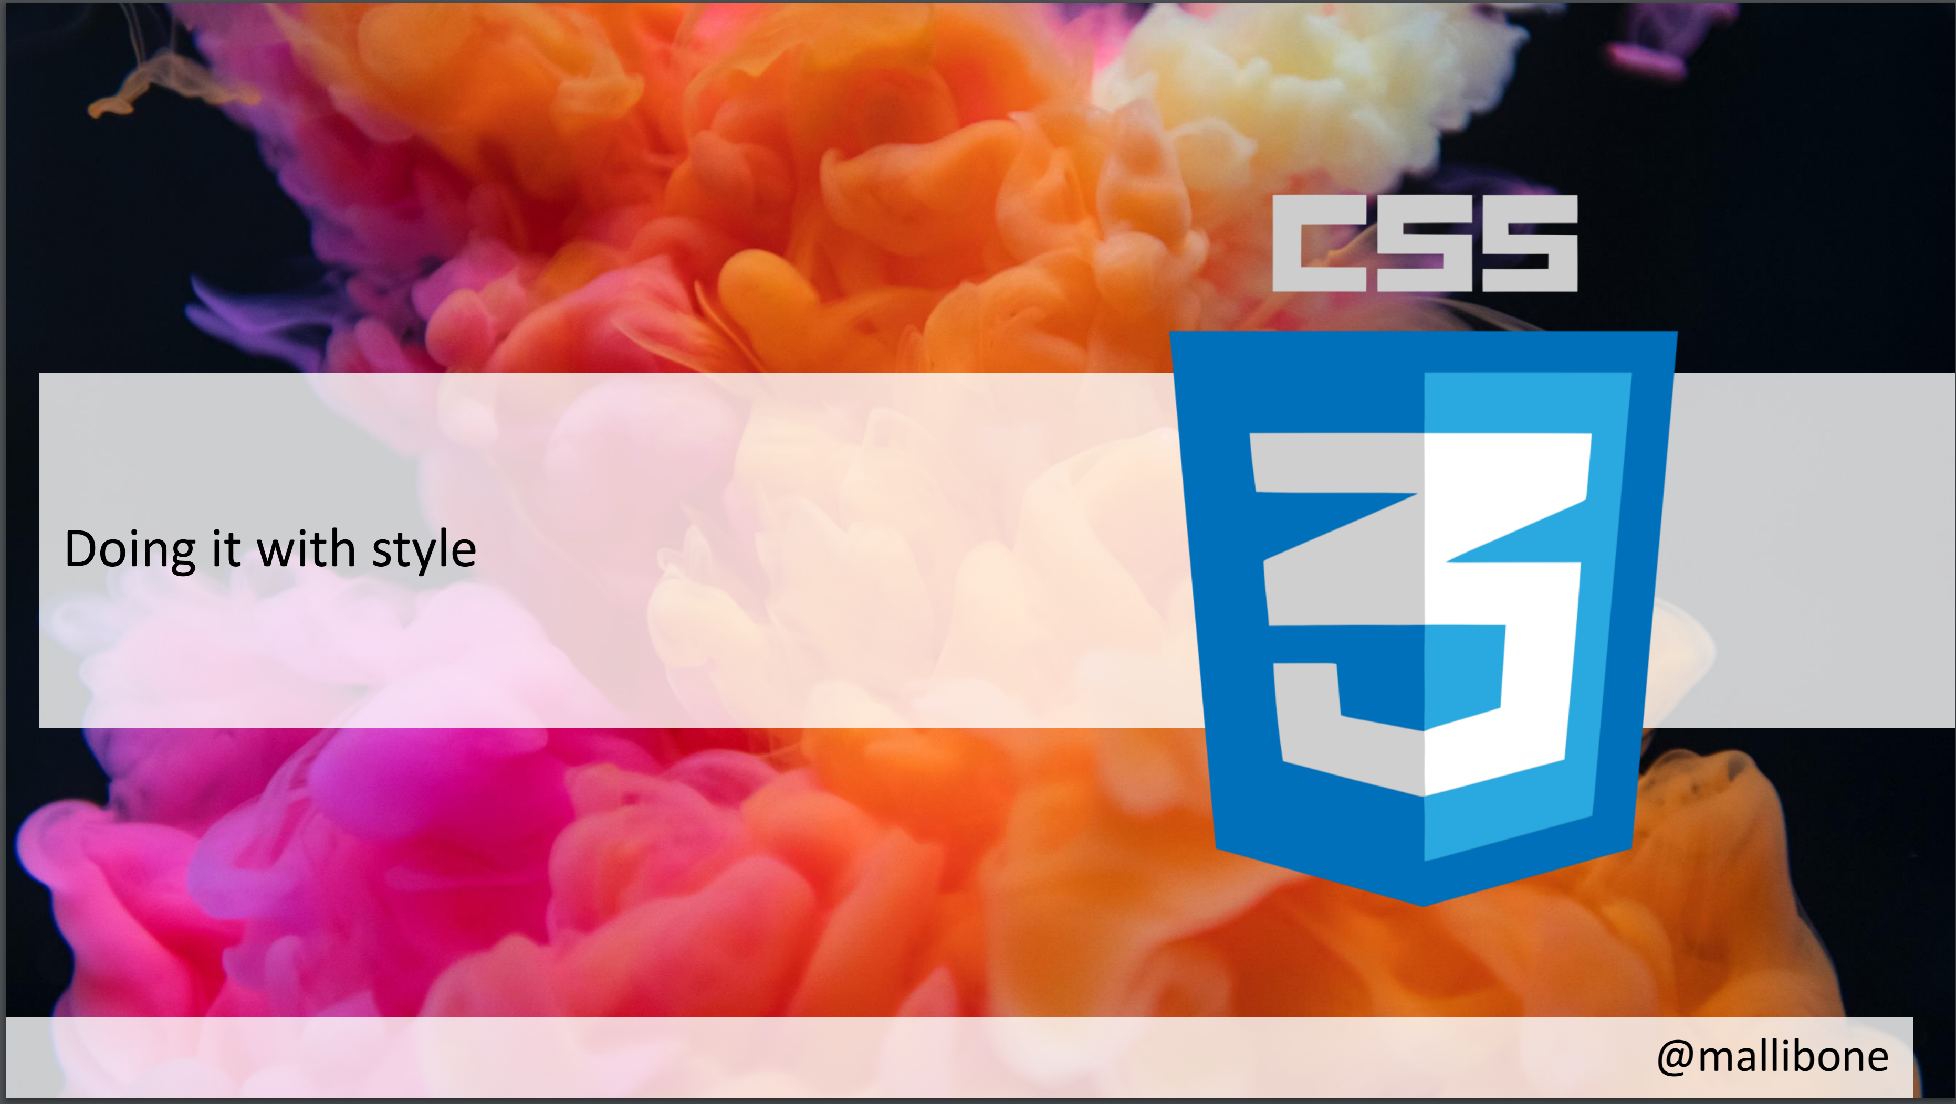

Slide 32
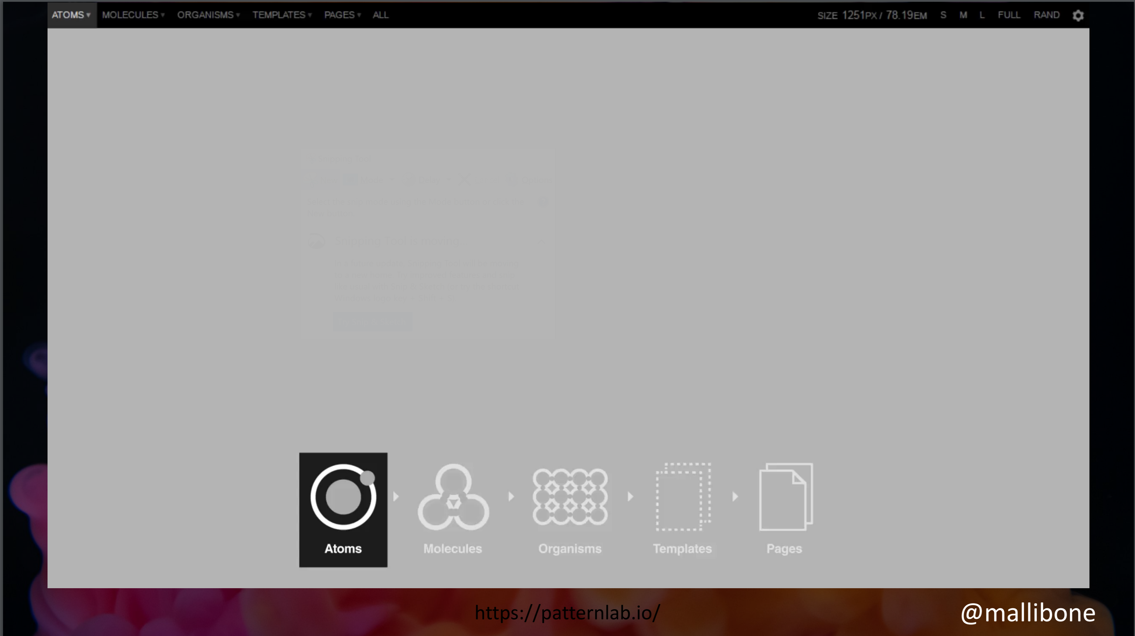
Notes:
1:37 in video

Slide 33
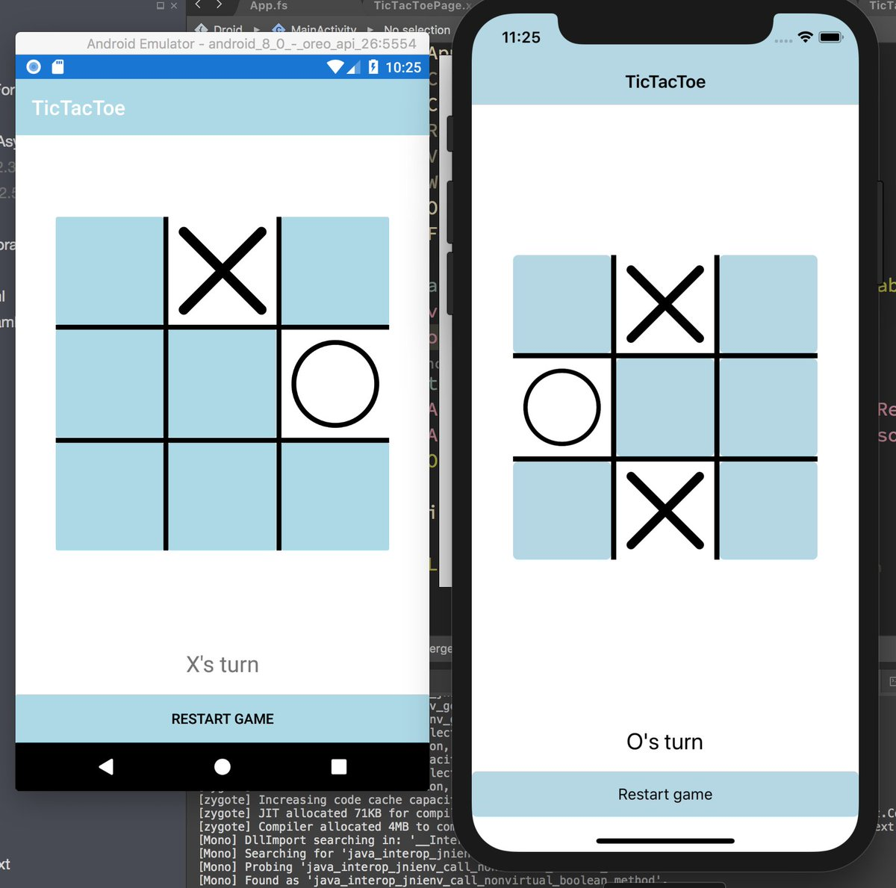
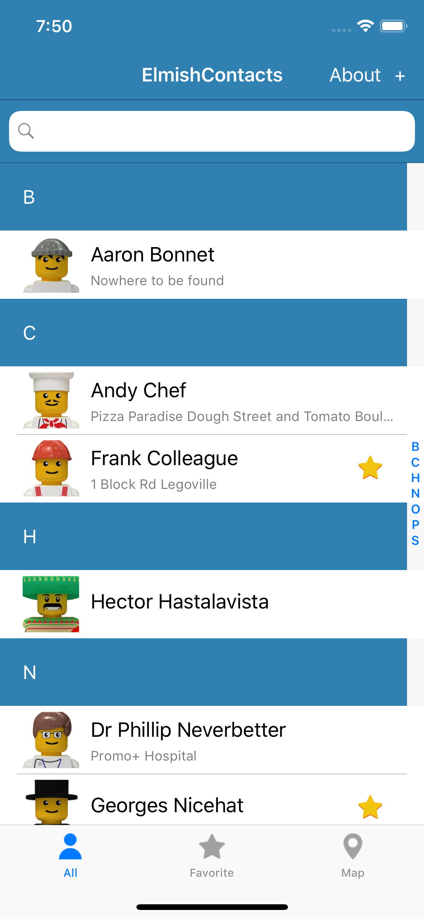
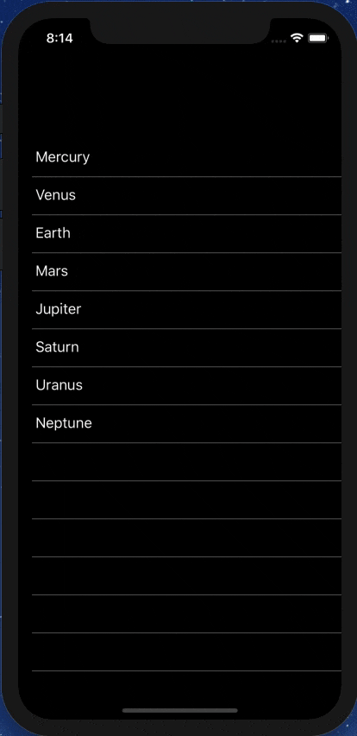
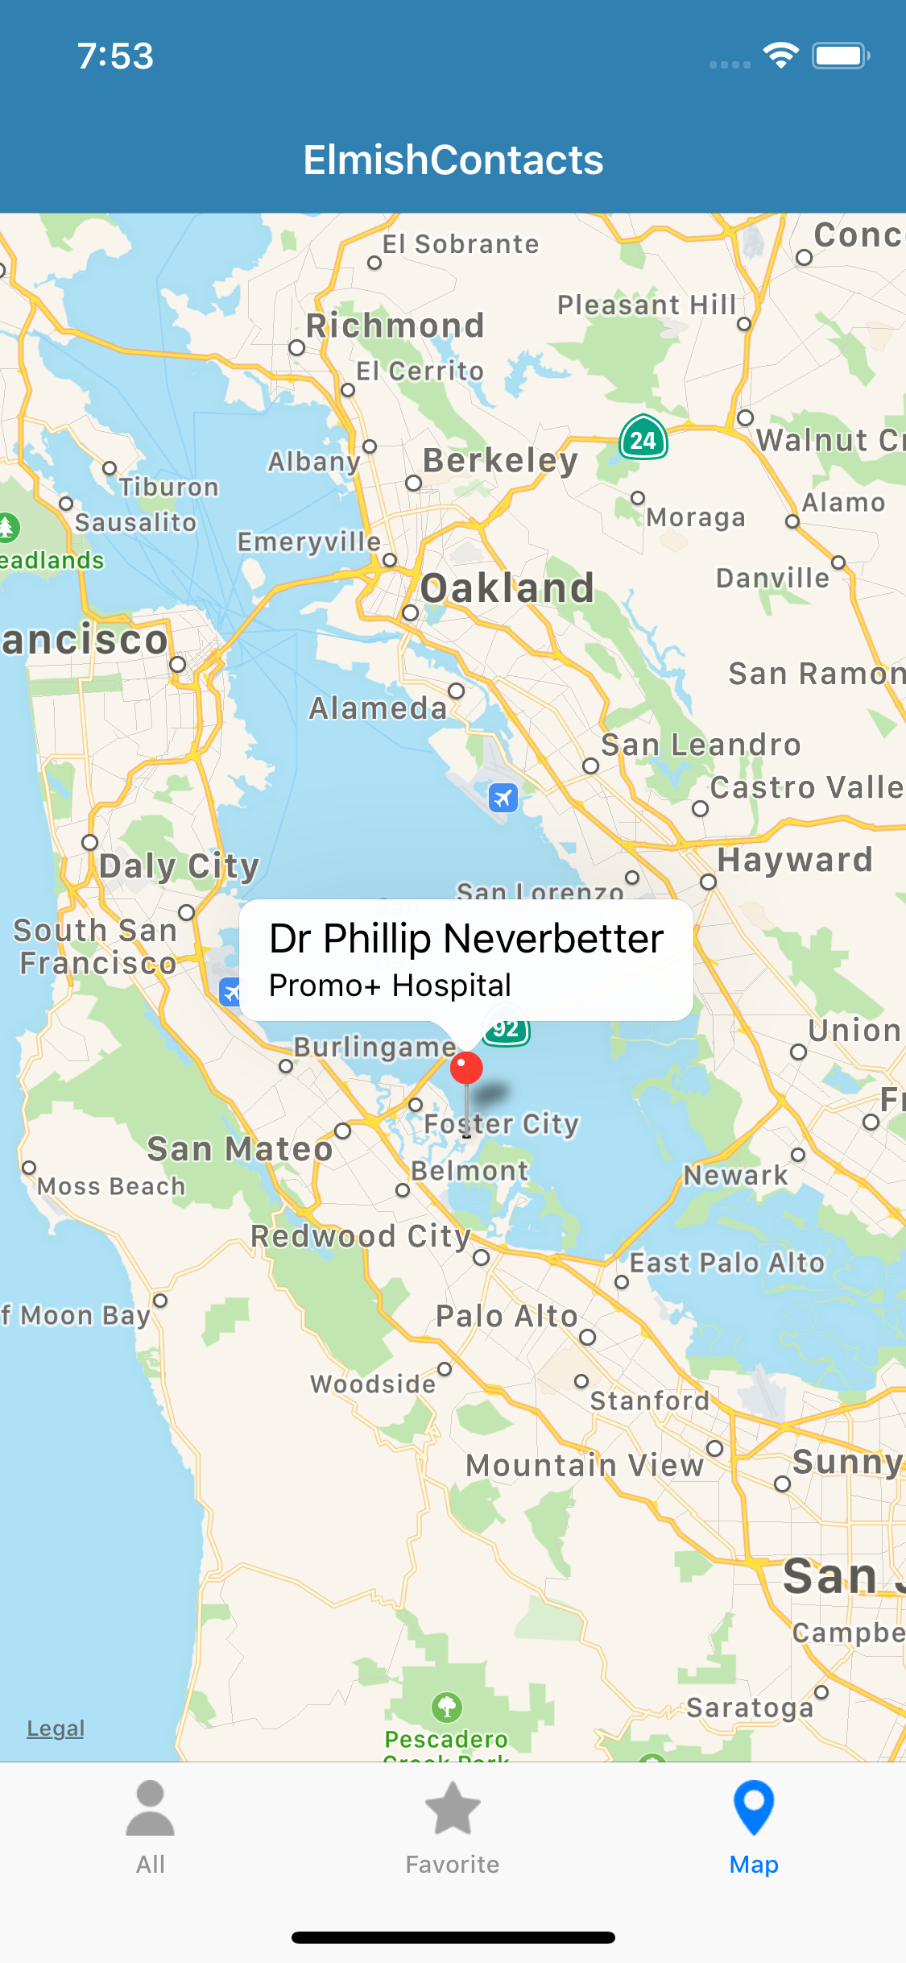
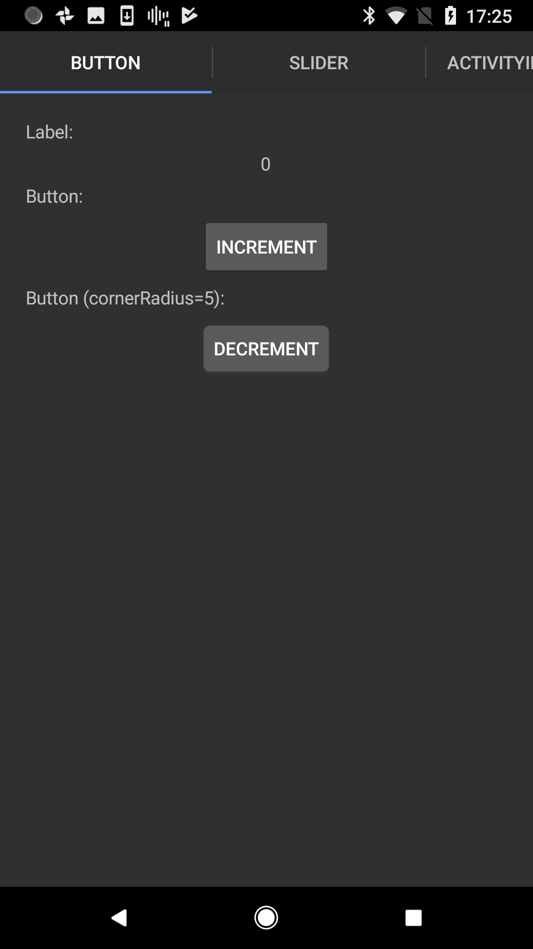

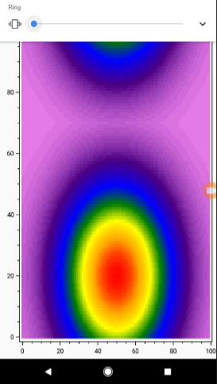


Slide 34
ELMISH CONTACTS

Slide 35
LEARN!
ElmishContacts is a great example
On-device per-app SQL-Lite integration
Using maps
Asynchronous data loading onto maps
Catching exceptions and being robust
Sending SMS, making phone calls and Email using Xamarin.Essentials
Multi-page with external messages reconciled via the composed app
Editing and searching lists of things
Taking photos
Splash screens
Decent design

Slide 36
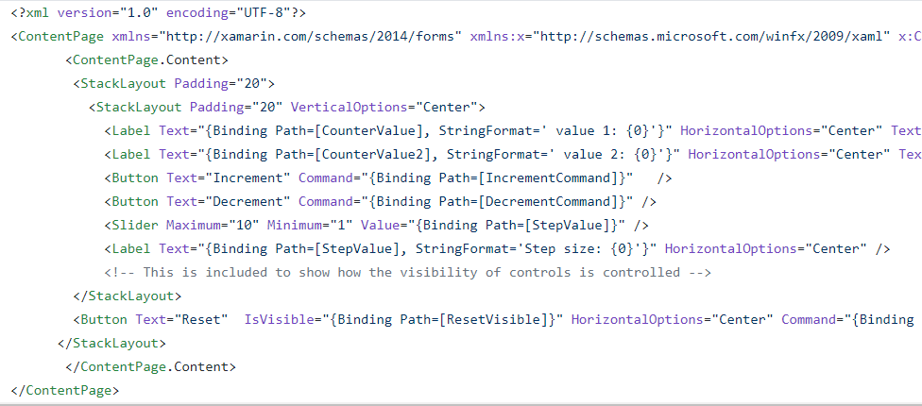
The VIEW DSL
Xaml looks like this:

Slide 37
The VIEW DSL
View looks like this:
let view (model: Model) dispatch =
View.ContentPage(content=
View.StackLayout(padding=30.0,verticalOptions = LayoutOptions.Center, children=[
View.Label(text= string model.Count, horizontalOptions=LayoutOptions.Center)
View.Button(text="Increment", command= (fun () -> dispatch Increment))
View.Button(text="Decrement", command= (fun () -> dispatch Decrement))
View.Slider(minimum=0.0, maximum=10.0, value=model.Step,
valueChanged= (fun args -> dispatch (SetStep (int args.NewValue))))
View.Label(text=sprintf "Step size: %d" model.Step, horizontalOptions=LayoutOptions.Center)
View.Button(text="Reset", horizontalOptions=LayoutOptions.Center,
command=(fun () -> dispatch Reset), canExecute = model.Changed)
]))

Slide 38
The VIEW DSL
View looks like this:
let view (model: Model) dispatch =
View.ContentPage(content=
View.StackLayout(padding=30.0,verticalOptions = LayoutOptions.Center, children=[
View.Label(text= string model.Count, horizontalOptions=LayoutOptions.Center)
View.Button(text="Increment", command= (fun () -> dispatch Increment))
View.Button(text="Decrement", command= (fun () -> dispatch Decrement))
View.Slider(minimum=0.0, maximum=10.0, value=model.Step,
valueChanged= (fun args -> dispatch (SetStep (int args.NewValue))))
View.Label(text=sprintf "Step size: %d" model.Step, horizontalOptions=LayoutOptions.Center)
View.Button(text="Reset", horizontalOptions=LayoutOptions.Center,
command=(fun () -> dispatch Reset), canExecute = not model.Unchanged)
]))
How easy is that?

Slide 39
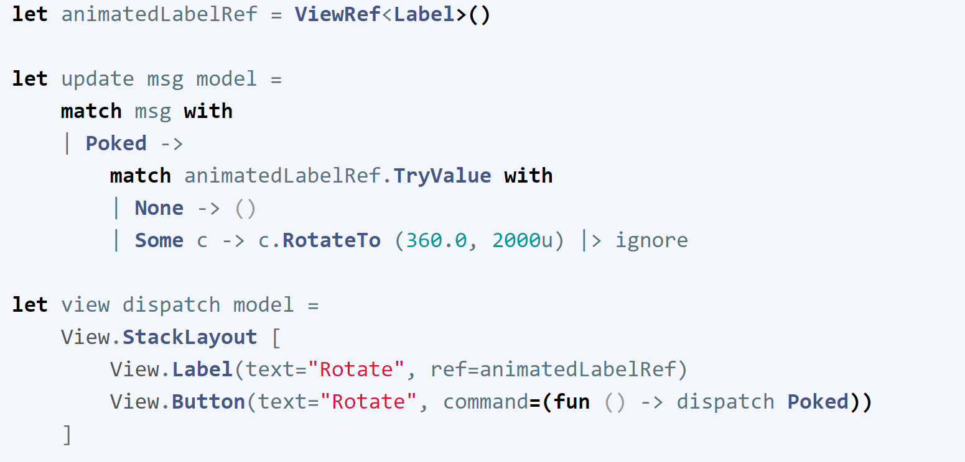
Animations
Uses “refs” like React

Slide 40
Multi-page apps
Yes you can
Still a single view function
CarouselPage, TabbedPage, NavigationPage with child pages
Each page has a model, message type and update function
You compose the pieces using F# code

Slide 41
Making it efficient
let view model dispatch =
…
View.Slider(minimum=0.0, maximum=10.0,
value=double model.Count,
valueChanged=(fun args -> dispatch (SliderValueChanged args.NewValue)))
…

Slide 42
Making it efficient
let view model dispatch =
…
dependsOn (…) (fun model (count, step) ->
…
)
…

Slide 43
Making it efficient
let view model dispatch =
…
dependsOn (model.Count, model.Step) (fun model (count, step) ->
View.Slider(minimum=0.0, maximum=10.0,
value=double count,
valueChanged=(fun args -> dispatch (SliderValueChanged args.NewValue))))
…

Slide 44
Pragmatics
State persistence
Prototyping simple, just serialize model to json
Time-travel debugging
Not enabled by default but easy to add as an in-app feature, app.SetModel(model)
App size
See notes in documentation. Standard Xamarin linking/reduction can be applied
Platform-specifics
Your core app is .NET Standard 2.0
Each platform has a head project (App.Droid, App.iOS) and initialization
You can pass in platform helpers
Or use platform conditionals
Deploying
App store deployment and signing follows usual Xamarin processes, linked in docs

Slide 45
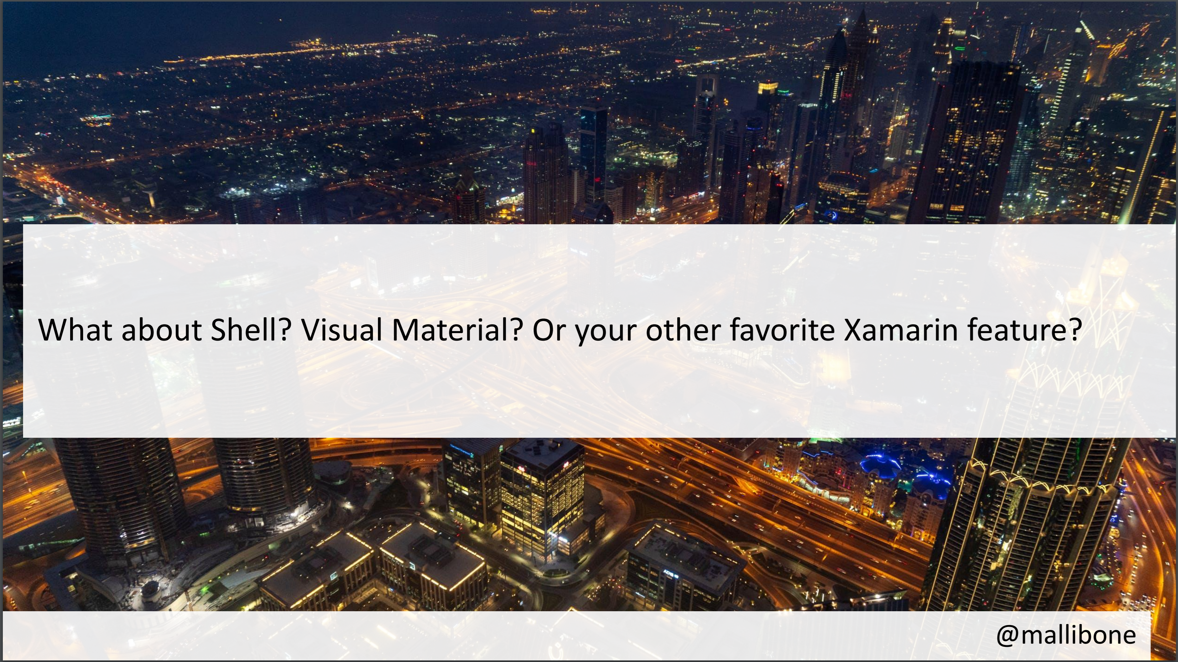

Slide 46


Slide 47
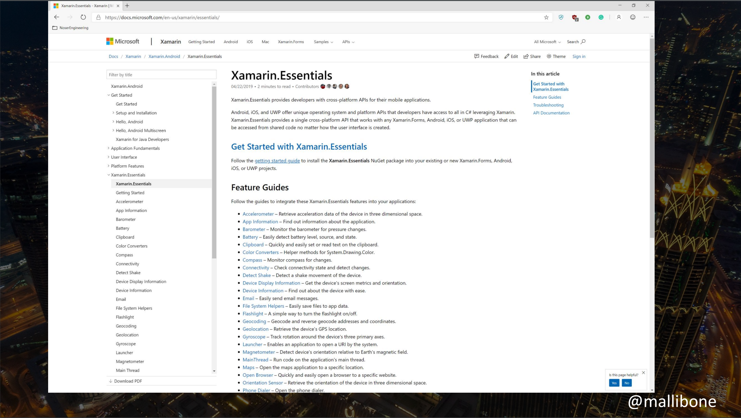

Slide 48
EXTENSIBILITY
You can define your own view extensions easily
Available extensions
Maps (native maps, fully open source)
SkiaSharp (2D graphics and animations , fully open source)
OxyPlot (really great charting, fully open source)
Urho (3D graphics, fully open source)
Each in its own small DLL
Please contribute your own!

Slide 49
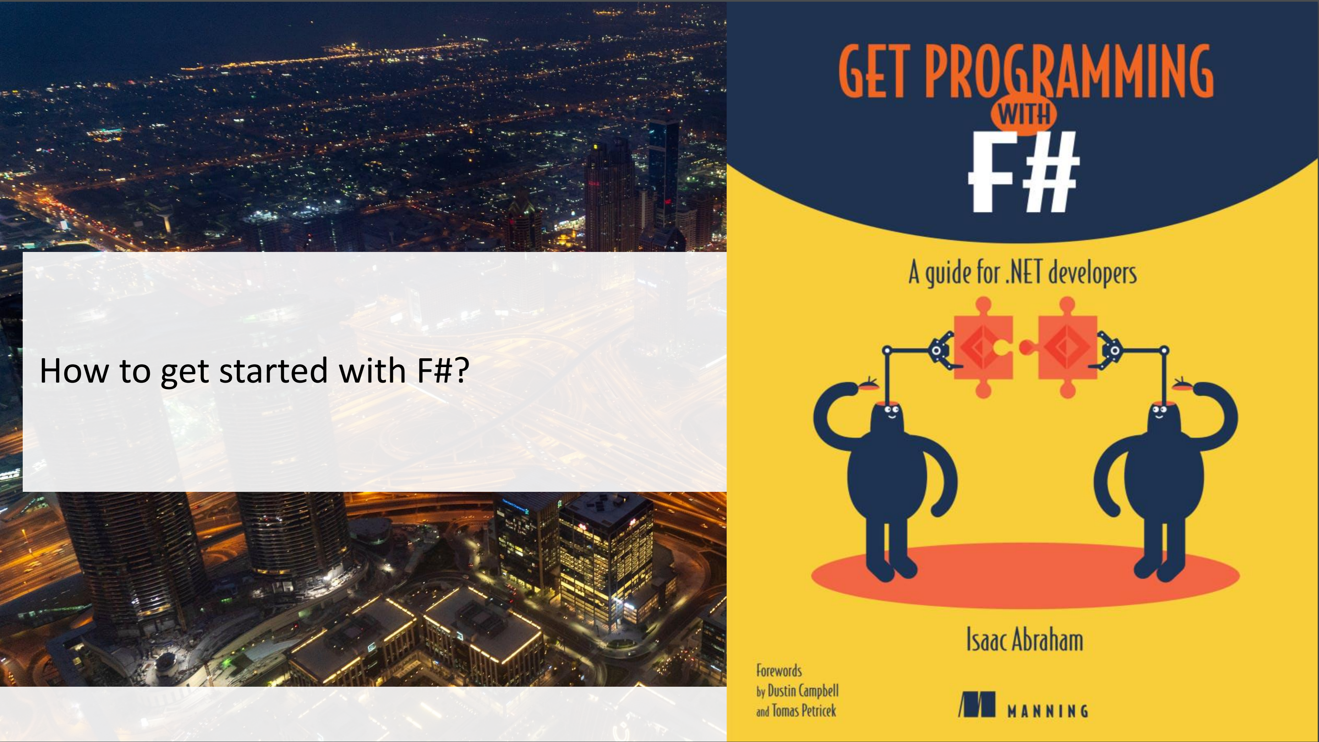

Slide 50
SUMMARY
Fabulous
=
Simple F#-friendly MVU App Programming
Please contribute and get involved!

Slide 51
Resources
fsprojects.github.io/Fabulous
View snippets
Docs
Links to Samples
Templates
How to use LiveUpdate (for small apps)
The AllControls sample
Awesome-Fabulous
Xamarin.Essentials
Xamarin docs (e.g.Forms, Android, iOS setup and deploy)
github.com/mallibone/FabulousIntro

Slide 52
Backup Slides

Slide 53
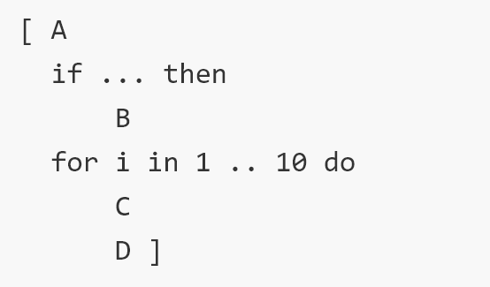
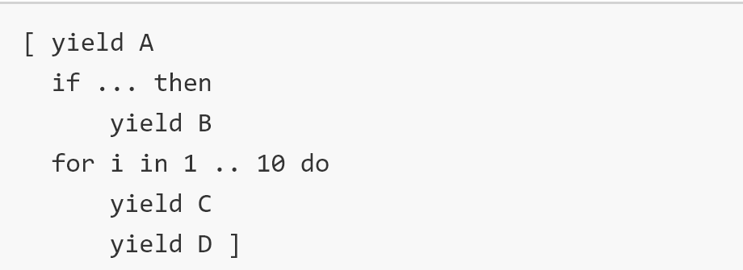
Why not C# 8.0?
Declaring message types is too clumsy
No records, pattern matching on them
No { r with Foo = … }
No unions
Declaring immutable dynamic views is clumsy
No expression-based computed collections, the iterator methods of C# are too clumsy for this - you need iterator expressions integrated with collection

Slide 54
CHEATING
Some cheats are available
created=(fun control -> …):
Lets you access underlying control on creation/recreation
View.Stateful:
adds local mutable state unrelated to the model. Breaks the functional approach but has uses for ephemeral state and rapid-mutation code.
View.WithInternalModel:
similar but for local immutable state
View.External:
wraps external Xamarin Forms objects, e.g. Page or View.

Slide 55
How to think: composition
“The pieces compose separately”
Compose the models, messages, update functions, view functions separately
“External” messages must be resolved during composition
“Encapsulation is not the emphasis”
The sub-page models not hidden when composed
OO encapsulation is strongly de-emphasized for model/view/update

Slide 56
THE SIMPLIFYING MAGIC
The magic is doing view re-evaluation

Slide 57
THE SIMPLIFYING MAGIC
The magic is doing view re-evaluation
(we use partial view re-evaluation and differential update to make it sufficiently efficient)

